Slide 1


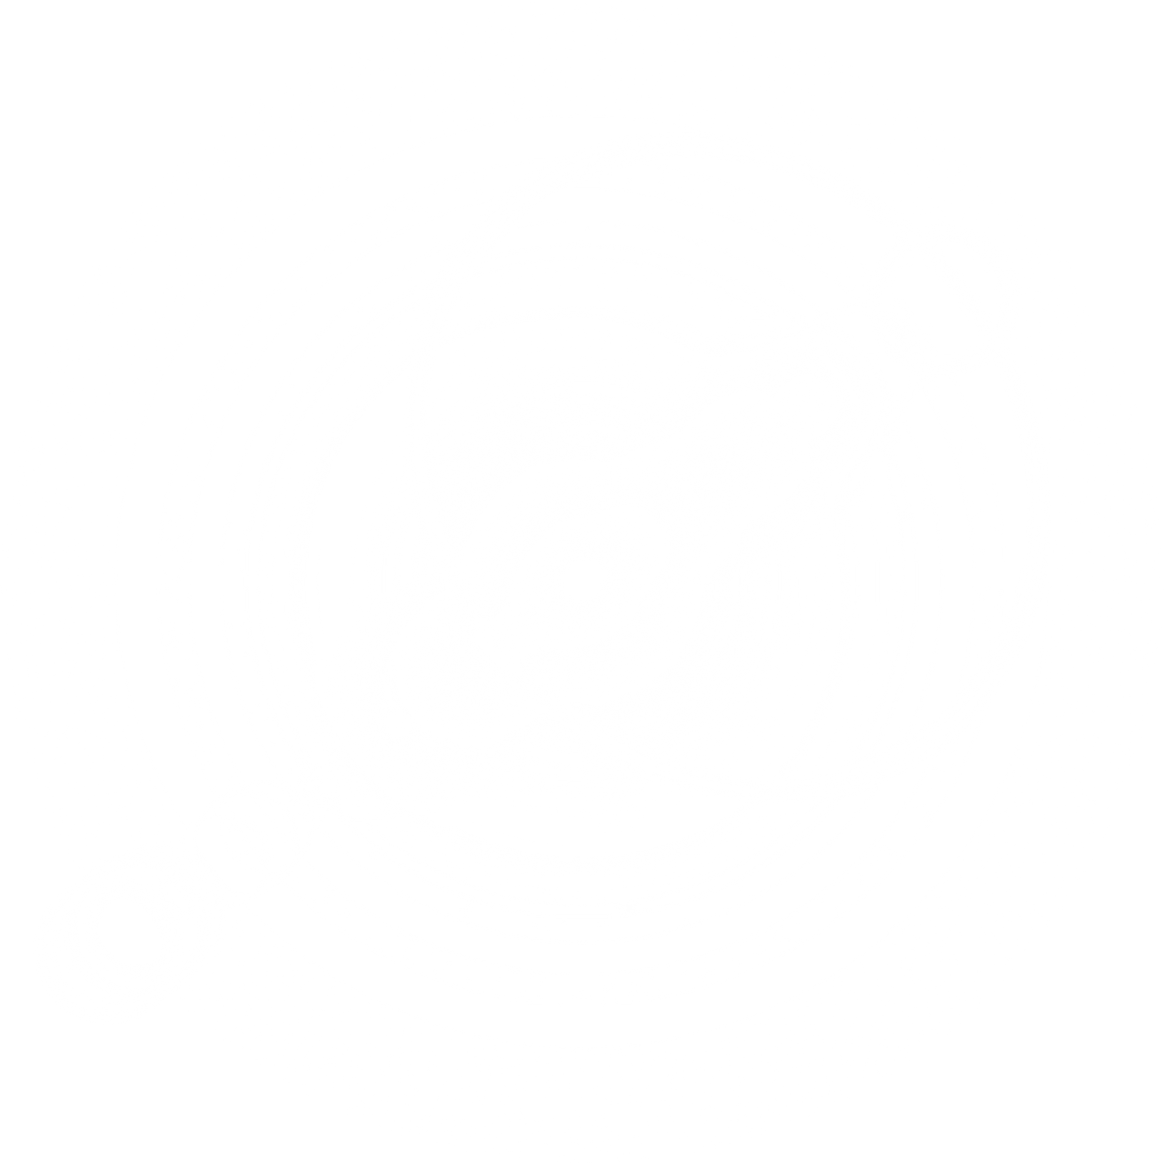
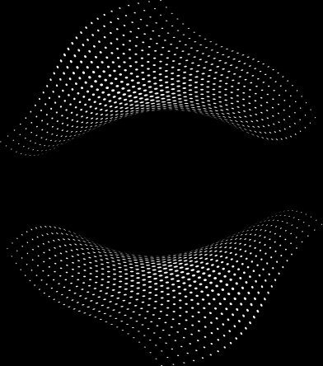
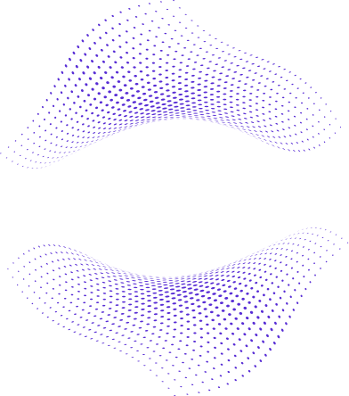
SELECTED LABS IN SOFTWARE ENGINEERING
WEATHER MONITORING SYSTEM PROJECT
FALL SEMESTER 2025

Slide 2


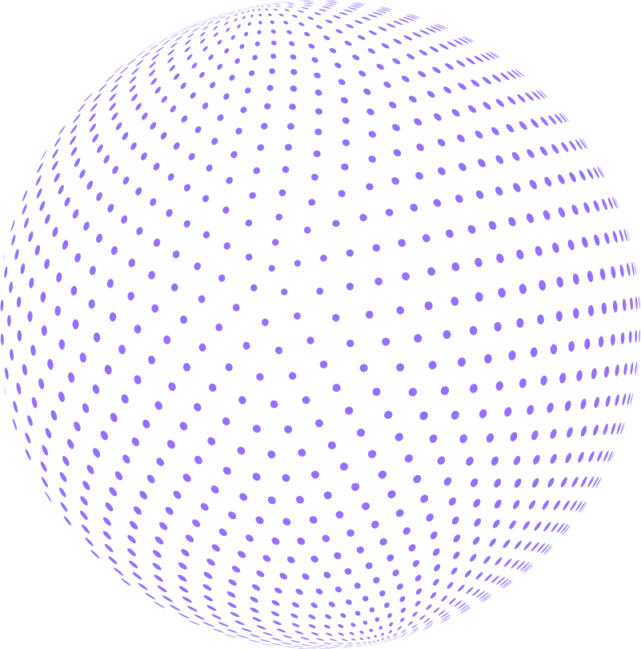
TEAM MEMBERS
01
Omar Khaled Mohamed Sobaih ( 21-02159 )
02
Youssef Medhat Shawky ( 21-01732 )
03
Bassant Bassem ( 21-00563 )

Slide 3


PROJECT DESCRIPTION
The Weather Monitoring System is a comprehensive application designed to collect, analyze, and present weather data in real-time. The system aims to provide users with accurate and up-to-date weather information, enabling them to make informed decisions based on current and forecasted weather conditions.

Slide 4


PROCESS
01
02
Data Collection
Data Processing
The system gathers weather data from various sources, including weather APIs, sensors, and meteorological databases. This data includes temperature, humidity, wind speed, precipitation, and atmospheric pressure.
The collected data is processed and analyzed to generate meaningful insights. This includes calculating averages, identifying trends, and forecasting future weather conditions.
03
04
User Interface
Alerts and Notifications
Users can interact with the system through a graphical user interface (GUI) that displays current weather conditions, forecasts, and historical data. The interface is designed to be intuitive and user-friendly.
The system can send alerts and notifications to users regarding severe weather conditions, ensuring they are well-informed and can take necessary precautions.

Slide 5



FEATURES
01
02
03
REAL-TIME WEATHER UPDATES
CUSTOMIZABLE PREFERENCES
HISTORICAL DATA ANALYSIS
Users receive live updates on weather conditions in their specified locations
Users can set preferences for the types of weather data they wish to monitor and receive notifications for.
The system provides access to historical weather data, allowing users to analyze trends over time.

Slide 6
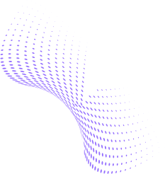

DESIGN PATTERNS
01
02
SINGLETON PATTERN
FACTORY PATTERN
03
04
05
TEMPLATE PATTERN
STRATEGY PATTERN
COMMAND PATTERN

Slide 7
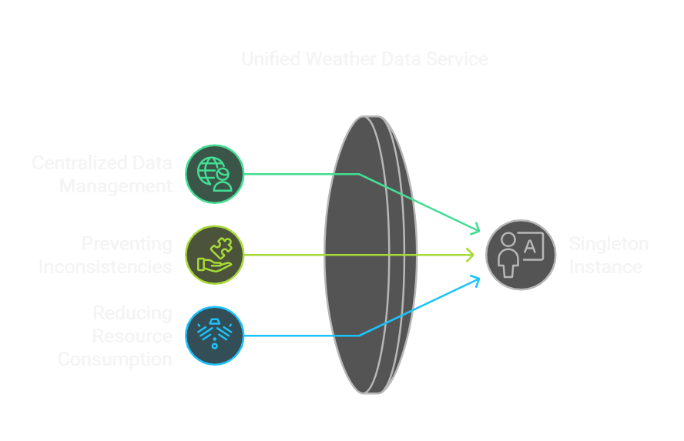

DESIGN PATTERNS
SINGLETON PATTERN
This pattern ensures that there is only one instance of the weather data service throughout the application.
This centralizes data management and access, preventing inconsistencies and reducing resource consumption.

Slide 8


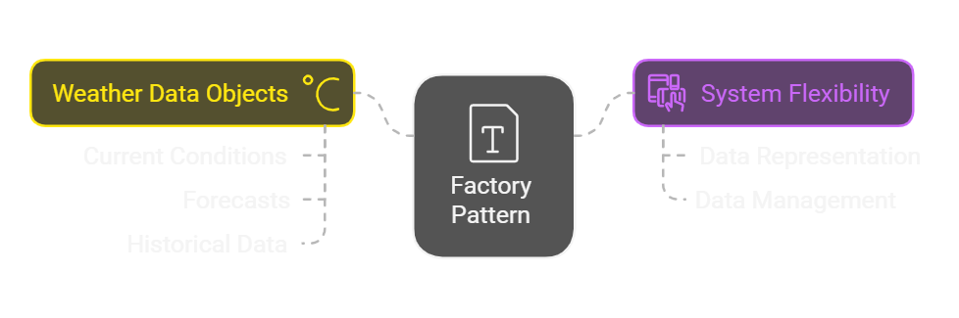
DESIGN PATTERNS
FACTORY PATTERN
The factory pattern is utilized to create different types of weather data objects (e.g., current conditions, forecasts, historical data). This allows for flexibility in how weather data is represented and managed within the system.

Slide 9

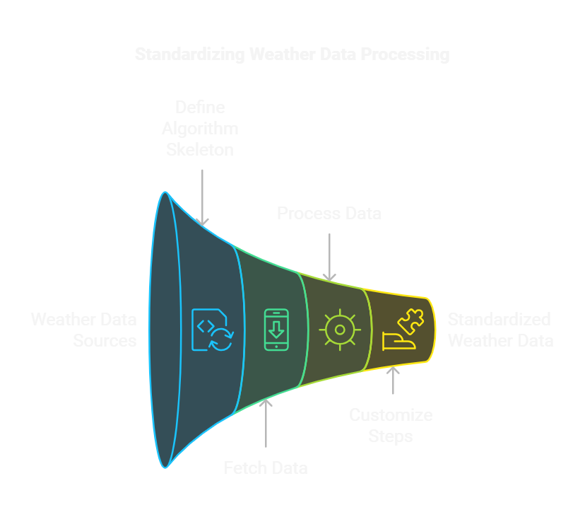
DESIGN PATTERNS
TEMPLATE PATTERN
The template pattern defines the skeleton of an algorithm in a method, allowing subclasses to redefine certain steps without changing the algorithm's structure.
In this system, it is used to standardize the process of fetching and processing weather data while allowing customization for different data sources.

Slide 10
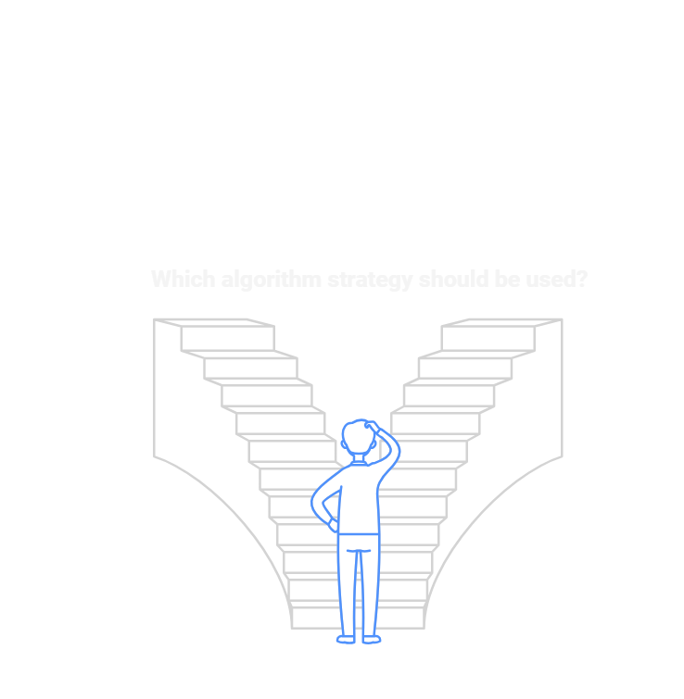
DESIGN PATTERNS
STRATEGY PATTERN
This pattern is employed to define a family of algorithms for weather data processing and forecasting.
The system can switch between different processing strategies (e.g., statistical analysis, machine learning models) based on user preferences or specific requirements.

Slide 11
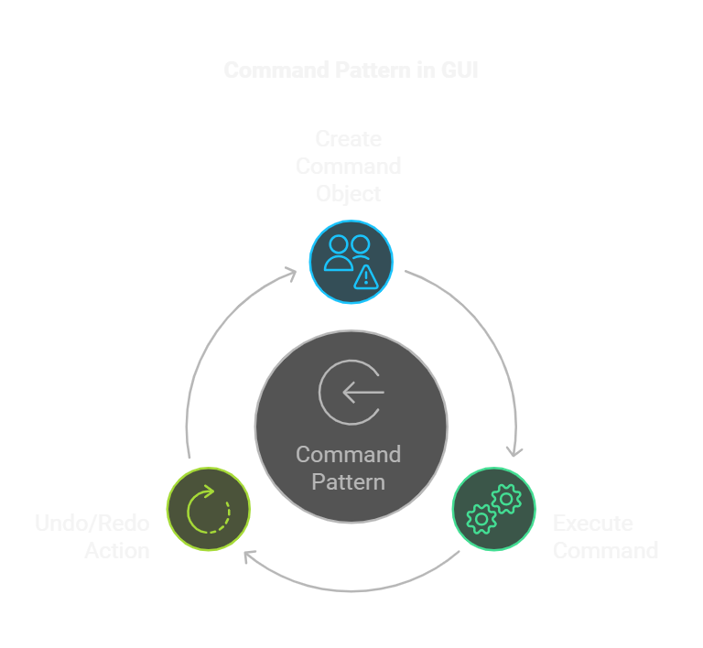
DESIGN PATTERNS
COMMAND PATTERN
The command pattern is implemented within the GUI to encapsulate user actions as command objects.
This allows for features like undo/redo functionality, where users can easily revert or reapply their actions (e.g., changing settings or updating preferences).
Each command is executed through a command invoker, enhancing the flexibility and maintainability of the GUI interactions.

Slide 12
CONCLUSION
The Weather Monitoring System effectively combines real-time data management with user-friendly features. Utilizing design patterns such as Singleton, Factory, Template, Strategy, and Command, the system ensures maintainability and flexibility, providing users with essential weather information to make informed decisions.

Slide 13
THANK YOU

